Slide 1
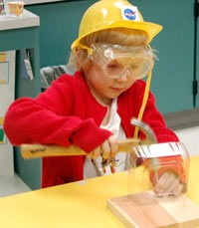
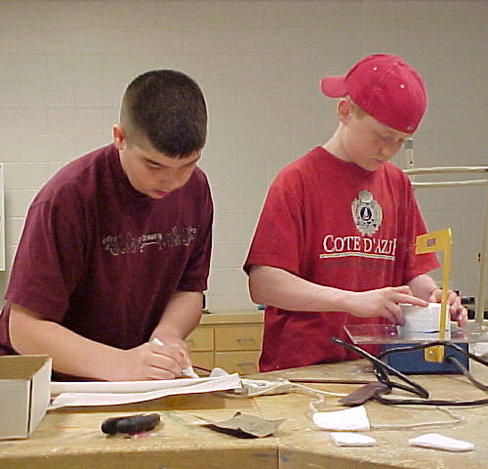
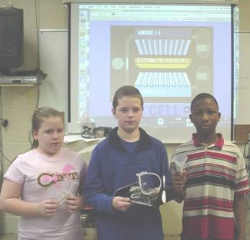

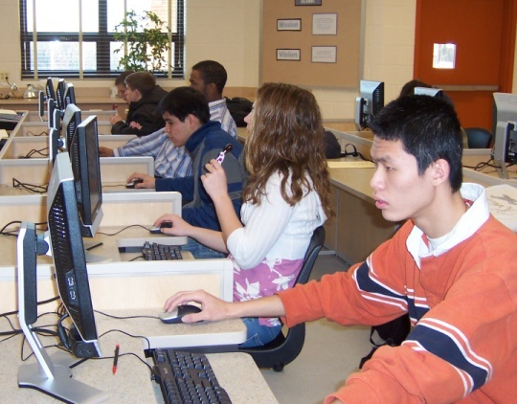


Technological Systems, 3rd Edition
Student Resource 1.1.1
Technological Systems: How They Work
© 2013 International Technology and Engineering Educators Association
STEMCenter for Teaching and Learning™
Technological Systems
Notes:
© International Technology Education Assoc
Slide #<number>
TITLE SLIDE
On this slide, specialists should insert the logo of the agency where you are visiting. This is usually accessed from the website. When arranging the speaking engagement, ask for a tif or jpg of the logo.
POST TITLE SLIDE:
When arriving at the workshop site, this slide should be on the screen approximately 10 – 15 minutes before the workshop begins.
SPECIAL NOTE:
We are now the STEM Center for Teaching & Learning. Our focus is on teaching and learning.
12/01/2009
STEMCenter for Teaching & Learning™ Engineering byDesign™

Slide 2
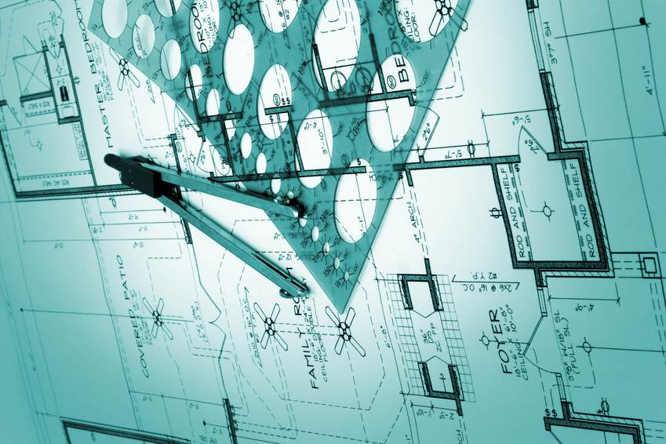
Unit Big Idea
Technological Systems are designed and developed following specific criteria.
© 2013 International Technology and Engineering Educators Association
STEMCenter for Teaching and Learning™
Technological Systems
Notes:
Help students to discuss examples of systems, particularly those that they would encounter in their lives.
© International Technology Education Assoc
Slide #<number>
12/01/2009
STEMCenter for Teaching & Learning™ Engineering byDesign™

Slide 3
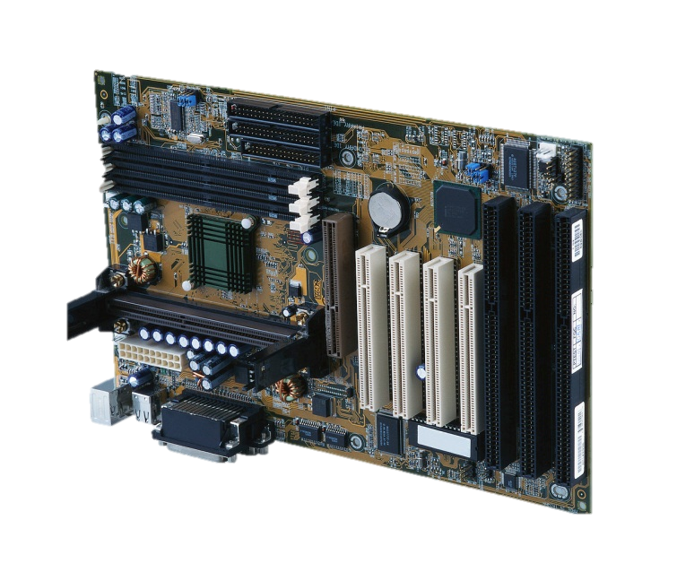





What is a technological system?
A human-made group of parts that work together as a unit.
© 2013 International Technology and Engineering Educators Association
STEMCenter for Teaching and Learning™
Technological Systems
Notes:
Help students to discuss examples of systems, particularly those that they would encounter in their lives.
© International Technology Education Assoc
Slide #<number>
12/01/2009
STEMCenter for Teaching & Learning™ Engineering byDesign™

Slide 4



What makes a system?
Input
Processes
Output
Feedback
© 2013 International Technology and Engineering Educators Association
STEMCenter for Teaching and Learning™
Technological Systems
Notes:
Explain the systems loop, including closed systems (with feedback) and open systems (without feedback). Through discussion, help students to relate the systems model to other systems.
© International Technology Education Assoc
Slide #<number>
12/01/2009
STEMCenter for Teaching & Learning™ Engineering byDesign™

Slide 5
Requirements of Systems
What kinds of things might be required to make a system?
Inputs: something that goes into a system, a resource
such as time, money, communication, etc.
Processes: something that happens to or with the inputs.
Outputs: what comes out of the process, the finished product,
or completed process.
Feedback: Information given about the output of the system.
© 2013 International Technology and Engineering Educators Association
STEMCenter for Teaching and Learning™
Technological Systems
Notes:
Help students to brainstorm other system requirements.
© International Technology Education Assoc
Slide #<number>
12/01/2009
STEMCenter for Teaching & Learning™ Engineering byDesign™

Slide 6

Invention
What is an invention?
A process of turning ideas and imagination into devices and systems.
Can you name some devices or systems that were invented in the past 20 years?
© 2013 International Technology and Engineering Educators Association
STEMCenter for Teaching and Learning™
Technological Systems
Notes:
Students will likely name electronic devices, but through the discussion, help them to think about other systems as well, such as medical technologies, communication systems and manufacturing or construction systems.
© International Technology Education Assoc
Slide #<number>
12/01/2009
STEMCenter for Teaching & Learning™ Engineering byDesign™

Slide 7
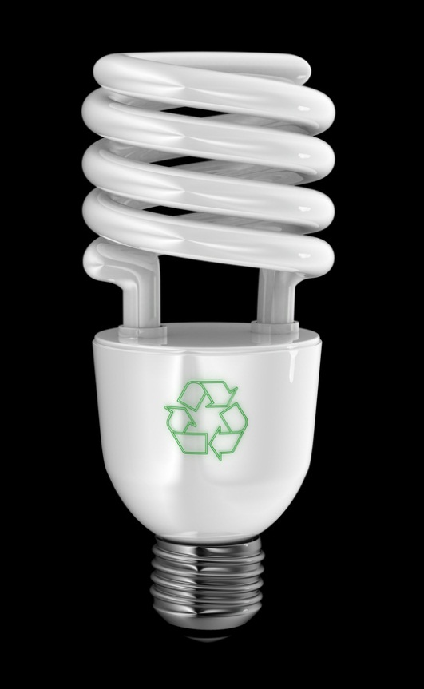

Innovation
What is an innovation?
The process of modifying an existing product to improve it.
© 2013 International Technology and Engineering Educators Association
STEMCenter for Teaching and Learning™
Technological Systems
Notes:
Make sure that students are clear on the differences between invention and innovation by comparing the processes with examples.
© International Technology Education Assoc
Slide #<number>
12/01/2009
STEMCenter for Teaching & Learning™ Engineering byDesign™

Slide 8

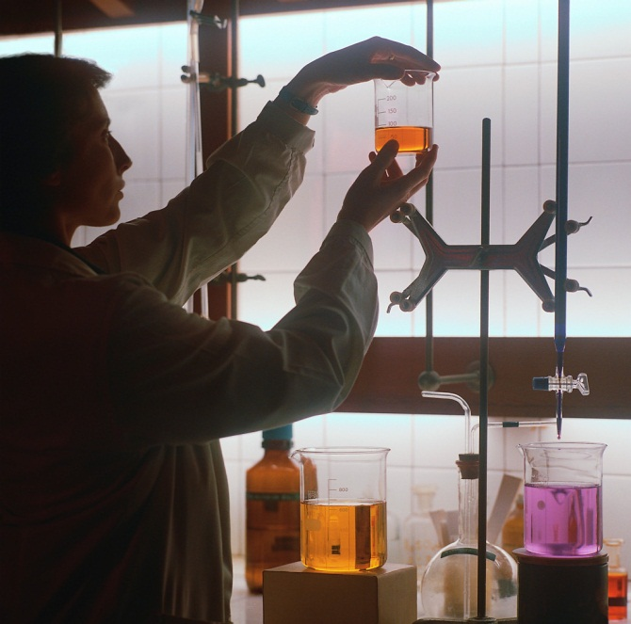
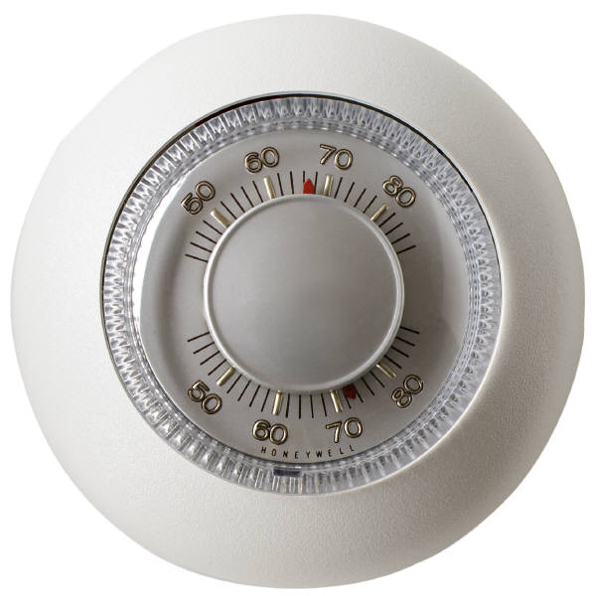

System Development
What changes over time led to advances in systems?
Control Systems
Standards
Discovery of new materials and processes
© 2013 International Technology and Engineering Educators Association
STEMCenter for Teaching and Learning™
Technological Systems
Notes:
Control Systems: are integrated into another system in the function of that system. They may also be used in the building of a system. Controls: These components are part of a system that determine how it functions and how the components interact.
Standards: be sure to discuss measurement and standardized parts as opposed to building one object at a time, with individually designed parts, such as early automobiles.
Discovery of new materials and process: i.e. machine tools as opposed to doing things by hand in large scale productions
© International Technology Education Assoc
Slide #<number>
12/01/2009
STEMCenter for Teaching & Learning™ Engineering byDesign™

Slide 9

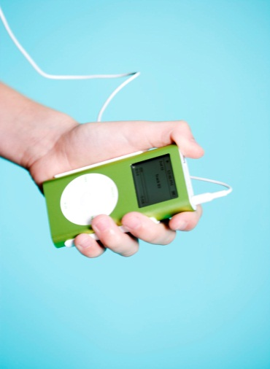
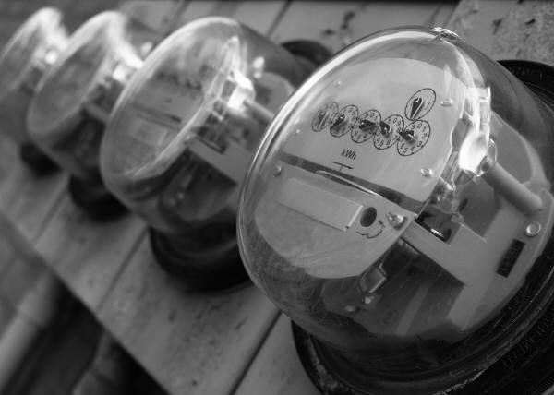

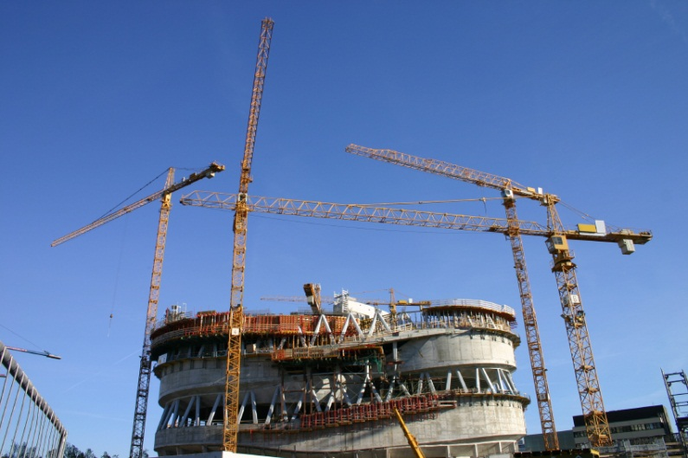
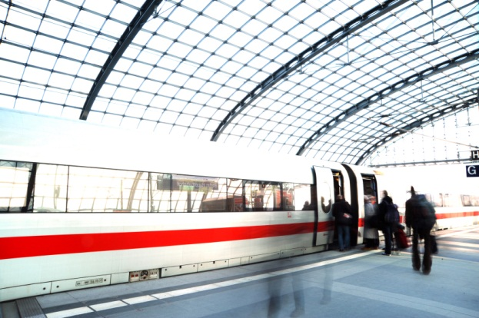
Technology in Systems
What advances in systems can you name that would not be possible without technology?
© 2013 International Technology and Engineering Educators Association
STEMCenter for Teaching and Learning™
Technological Systems
Notes:
If needed, remind students that technology is any object, environment or process that was created by humans, not just electronics or computers.
© International Technology Education Assoc
Slide #<number>
12/01/2009
STEMCenter for Teaching & Learning™ Engineering byDesign™

Slide 10
References
Lindbeck, J., Williams, M., & Wygant, R. (1990). Manufacturing Technology. Englewood Cliffs, NJ: Prentice Hall.
Moaveni, S. (2005). Engineering Fundamentals: An Introduction to Engineering, Toronto, ON: Thomson Canada Limited.
Samuel, A. (2006).Make and Test Projects in Engineering Design: Creativity,Engagement and Learning, London, England: Springer Publications.
Thode, B., Thode, T. (2002). Technology In Action, New York, NY: Glencoe McGraw-Hill.
Wright, P. (2001). 21st Century Manufacturing. Englewood Cliffs, NJ: Prentice Hall.
© 2013 International Technology and Engineering Educators Association
STEMCenter for Teaching and Learning™
Technological Systems
Notes:
© International Technology Education Assoc
Slide #<number>
12/01/2009
STEMCenter for Teaching & Learning™ Engineering byDesign™

